Slide 1
Fundamentals of Business Strategy and Entrepreneurial Opportunity
Mgt 663
Professor Tom Dean, Ph.D., MBA

Slide 2
AGENDA - Fundamentals of Business Strategy and Entrepreneurial Opportunity
1. Purpose and Role of Firms
2. Strategic Management Content
Industry Effects and Analysis
Firm Effects and Business-Level Strategy
3. Economic Opportunity
Opportunity Discovery
Opportunity Creation

Slide 3
What is the Role of “Firms” in Market-Based Economies? In other words, why do we have them?

Slide 4
The Role of Firms in Market-Based Economies
Firms exist to create value for consumers
“Satisfy needs and wants”
Firms take activities out of the hands of market
Into a hierarchical structure – “Markets vs. Hierarchies”
Markets exist at the boundaries of the firm (for customers, suppliers, and capital)
Markets discipline firms to create value, price competitively, and maximize profits. To be efficient and effective…

Slide 5
Top Management is ultimately responsible for the firm’s “performance”

Slide 6
Top Management is ultimately responsible for the firm’s “performance”
Maximize profit?
Subject to constraints of
1. Legal system
2. Pressures from constituencies
Determined by the goals/mission of the organization, but…

Slide 7
Friedman on Donahue Discussing Free Market/Capitalism (3 minutes)
Freeman summarizing Stakeholder Theory (3 minutes)
“There is one and only one social responsibility of business–to use it resources and engage in activities designed to increase its profits so long as it stays within the rules of the game, which is to say, engages in open and free competition without deception or fraud”
Milton Friedman

Slide 8
Stakeholders:
Groups who are affected by a firm’s performance and who have claims on its wealth
The firm must maintain performance at an adequate level in order to
maintain the participation of key stakeholders
Societal Constituencies
Capital Market
Firm
Stock market/Investors
Debt suppliers/Banks
Product Market
Organizational
Primary Customers
Suppliers
Employees
Managers
Non-Managers
Notes:
59

Slide 9
Business Roundtable Statement on the Purpose of a Corporation
While each of our individual companies serves its own corporate purpose, we share a fundamental commitment to all of our stakeholders. We commit to:
Delivering value to our customers. We will further the tradition of American companies leading the way in meeting or exceeding customer expectations.
Investing in our employees. This starts with compensating them fairly and providing important benefits. It also includes supporting them through training and education that help develop new skills for a rapidly changing world. We foster diversity and inclusion, dignity and respect.
Dealing fairly and ethically with our suppliers. We are dedicated to serving as good partners to the other companies, large and small, that help us meet our missions.
Supporting the communities in which we work. We respect the people in our communities and protect the environment by embracing sustainable practices across our businesses.
Generating long-term value for shareholders, who provide the capital that allows companies to invest, grow and innovate. We are committed to transparency and effective engagement with shareholders.
Each of our stakeholders is essential. We commit to deliver value to all of them, for the future success of our companies, our communities and our country.

Slide 10
“Strategic Management”
Fundamentally concerned with how to maximize organizational “performance”
Strategy Content
Strategy Process

Slide 11
“Strategic Management”
Strategy Content

Slide 12
Reflect…
Competition

Slide 13
Reflect…
Profit

Slide 14
“Economic Profit”
Profit above all costs including a risk-adjusted return to capital
Greater than investor’s opportunity cost
Economic profit is sometimes referred to as supernormal profit or economic rent
Economic profit does not occur in perfect competition.
Economic Profit is good:
If you are a business benefitting from it.
Economic Profit is bad:
Once risk is accounted for, long-lasting economic profit may be viewed as an inefficiency caused by monopolies or some form of market failure.
Unless accruing to superior assets or resource idiosyncracies

Slide 15
Value Creation vs. Value Capture
You must create value,
as well as protect it from “appropriation”
by customers, suppliers, competitors, and governments

Slide 16
Levels of Strategy
Business strategy:
How should the firm compete in a given business unit
Cost leadership, differentiation, vertical integration
Corporate strategy:
In which industries, sectors or business units should the firm compete?
Global strategy:
Where should the firm compete: local, regional, national, or international?

Slide 17
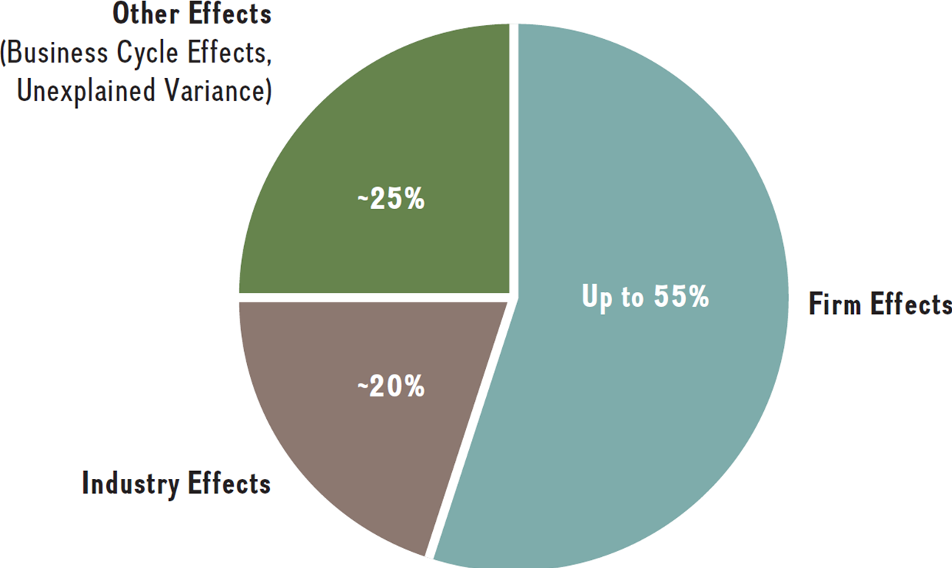
Industry Effects vs. Firm Effects In Determining Firm Financial Performance

Slide 18
Strategic Management Content
Industry Effects and Analysis
Market: “group of current and potential customers having the willingness and ability to buy product/services to satisfy a need.”
Industry: “group of sellers that offer product/services that are similar and close substitutes for one another.”

Slide 19
Types of Competition, Rivalry, and Economic Profit
Expected
Economic profit
Relative emphasis
on rivalry
Pure
Monopoly
Avoided
Competition
Hyper-
competition
Perfect
Competition
Public
Water Utility
Professional
Sports
Consumer
Electronics
Farming

Slide 20
Industry Structure
Concentrated or fragmented
Concentrated industries are dominated by a few large firms
Fragmented industries include a large number of smaller companies
General attractiveness
A structurally attractive industry has high barriers to entry, no good substitutes for the product, limited power of supplier, and limited power of buyers
Subsectors and growth areas
Notes:
In regard to industry concentration, you should report how concentrated or fragmented your industry is.
Concentrated industries are dominated by a few large firms, while fragmented industries include a large number of smaller companies.
The second topic regarding industry structure is the general attractiveness (or lack of attractiveness) of an industry’s competitive landscape.
A structurally attractive industry, according to Harvard professor Michael Porter’s “five forces” model, is that there should be relatively high barriers of entry to keep competitors out, not enough rivalry to create cutthroat competition, no good substitutes for the basic product or service the industry sells, limited power of suppliers to negotiate input prices up, and limited power of buyers to force selling prices down.

Slide 21
The Economist, 2016. Special Report: The Rise of the Superstars, Why Giants Thrive, and The New Methuselahs. September 17th

Slide 22
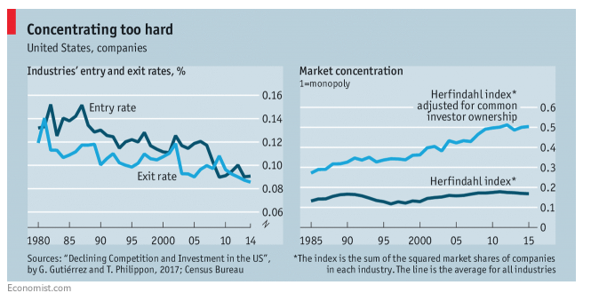
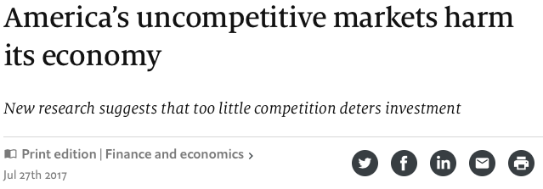
Notes:
where s_{i} is the market share of firm i in the market, and N is the number of firms. Thus, in a market with two firms that each have 50 percent market share, the Herfindahl index equals 0.50²+0.50² = 1/2.
The Herfindahl Index (H) ranges from 1/N to one, where N is the number of firms in the market. Equivalently, if percents are used as whole numbers, as in 75 instead of 0.75, the index can range up to 100², or 10,000.
An H below 0.01 (or 100) indicates a highly competitive industry. An H below 0.15 (or 1,500) indicates an unconcentrated industry. An H between 0.15 to 0.25 (or 1,500 to 2,500) indicates moderate concentration. An H above 0.25 (above 2,500) indicates high concentration.^{[5]}

Slide 23
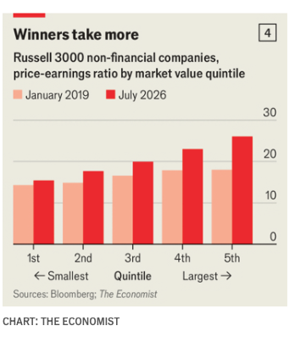
The Economist, July 6th 2026: Beware the top-heavy economy: Supersize capital flows are reshaping business—and building risk

Slide 24
Network Effects/Network Externalities
“Network effects arise where a buyer’s willingness to pay for a company’s product increases with the number of other buyers who also patronize the company”. Porter, 2008
“Buyers value being in a network with a larger number of fellow customers.” Porter, 2008
Examples
Craigslist
Ebay
TikTok
Facebook
LinkedIn
Computer Operating Systems and Applications (less so now than before)

Slide 25
Porter’s Five Forces
Model of Competition
Threat of New Entrants
Threat of New Entrants
Bargaining Power of Suppliers
Rivalry Among Competing Firms in Industry
Bargaining Power of Buyers
Threat of Substitute Products
Notes:
23

Slide 26
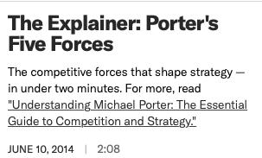
https://hbr.org/video/3590615226001/the-explainer-porters-five-forces

Slide 27
Porter’s Five Forces
Model of Competition
Threat of New Entrants
Threat of New Entrants
“Entrant” a firm that had not previously served a market begins operations therein
New-Firm vs. Diversifying Entrants
Entrants and “potential entrants” discipline markets
Threat of entry dependent is on
1. Expected Retaliation
2. Entry Barriers
Notes:
11

Slide 28
Threat of New Entrants
Economies of scale: manufacturing, marketing, technological
Customer loyalty: well established brands, long established relationships
Agreements with customers, suppliers, strategic partners
Switching costs
Capital requirements: high investment. Sunk cost?
Barriers to Entry

Slide 29
Threat of New Entrants
Access to distribution channels: exclusive distribution agreements, dominant position of competitors
Intellectual property: patents, trade secrets, copyrights, trademarks, know-how
Government regulations: Regulated monopolies, import restrictions
Hostility to new entrants: Use all means to drive out new competition: pricing, legal, spreading rumors
Network externalities and customer lock in
Barriers to Entry

Slide 30
Power of Suppliers and Buyers
Buyers and Suppliers can “appropriate” industry profits
Clarify Buyer, Supplier, Focal Industry
Buyer and Consumer are not always the same
Supplier
Focal
Industry
Buyer

Slide 31
Porter’s Five Forces
Model of Competition
Bargaining Power of Buyers
Notes:
20

Slide 32
Bargaining Power of Buyers
Buyer groups are likely to be powerful if:
Buyers are concentrated or purchases are large relative to seller’s sales
Purchase accounts for a significant fraction of industry’s sales
Buyers compete with the focal industry by:
Products are undifferentiated
* Bargaining down prices
Buyers face few switching costs
* Forcing higher quality
Buyers’ industry earns low profits
* Playing firms off of each other
Buyer presents a credible threat of backward integration
Product unimportant to quality
Buyer has full information
Notes:
18

Slide 33
Porter’s Five Forces
Model of Competition
Bargaining Power of Suppliers
Notes:
17

Slide 34
Bargaining Power of Suppliers
Suppliers are likely to be powerful if:
Suppliers exert power in the industry by:
Supplier industry is dominated by a few firms-the suppliers are “concentrated”
Suppliers’ products have few substitutes
* Threatening to raise
prices or to reduce quality
Focal industry/firm is not an important customer to supplier (low volume)
* Powerful suppliers can squeeze industry profitability if firms are unable to recover cost increases
Suppliers’ product is an important input to buyers’ product/process
Suppliers’ products are differentiated
Suppliers’ products have high switching costs
Supplier poses credible threat of forward integration
Notes:
15

Slide 35
Porter’s Five Forces
Model of Competition
Threat of Substitute Products
Notes:
20

Slide 36
Competing brands are not substitutes
Threat of Substitute Products
Keys to evaluate substitute products:
Products with similar function limit the prices firms can charge
Products with improving price/performance tradeoffs relative to present industry products
Examples:
Electronic security systems in place of security guards
Smart phones instead of traditional cameras
Notes:
21

Slide 37
Porter’s Five Forces
Model of Competition
Threat of New Entrants
Threat of New Entrants
Bargaining Power of Suppliers
Rivalry Among Competing Firms in Industry
Bargaining Power of Buyers
Threat of Substitute Products
Notes:
23

Slide 38
Rivalry Among Existing Competitors
Intense rivalry often plays out in the following ways:
Jockeying for strategic position
Using price competition
Staging advertising battles
Increasing consumer warranties or service
Making new product introductions
Occurs when a firm is pressured or sees an opportunity
Price competition often leaves the entire industry worse off
Advertising battles may increase total industry demand, but may be costly to smaller competitors
Notes:
25

Slide 39
Rivalry Among Existing Competitors
Cutthroat competition is more likely to occur when:
Numerous or equally balanced competitors
Slow growth industry
High fixed costs
High storage costs
Lack of differentiation or switching costs
Capacity added in large increments
Diverse competitors
High strategic stakes
High exit barriers
Notes:
26

Slide 40
Rivalry Among Existing Competitors
High exit barriers are economic, strategic and emotional factors which cause companies to remain in an industry even when future profitability is questionable.
Specialized assets
Fixed cost of exit (e.g., labor agreements)
Strategic interrelationships
Emotional barriers
Government and social restrictions
Notes:
27

Slide 41
Strategic Management Content
Firm Effects and Business-Level Strategy

Slide 42
Industry Effects vs. Firm Effects In Determining Firm Financial Performance

Slide 43
Strategy: Key Language
Competitive Advantage
Superior performance relative to other competitors in the same industry or the industry average
Sustainable Competitive Advantage
Outperforming competitors or the industry average over a prolonged period of time
Competitive Disadvantage
Underperformance relative to other competitors in the same industry or the industry average
Competitive Parity
Performance of two or more firms at the same level

Slide 44
Generic Business Level Strategies Michael Porter
Source of Competitive Advantage
Cost
Uniqueness
Cost
Leadership
Differen-
tiation
Broad
Target
Market
Breadth of Competitive Scope
Focused Differen-
tiation
Narrow
Target
Market
Focused Low Cost
Notes:
8

Slide 45
“Monopolistic Competition”

Slide 46
Reading Discussion
Firm Resources and Sustained Competitive Advantage
“The Resource-Based View of Competitive Strategy”

Slide 47
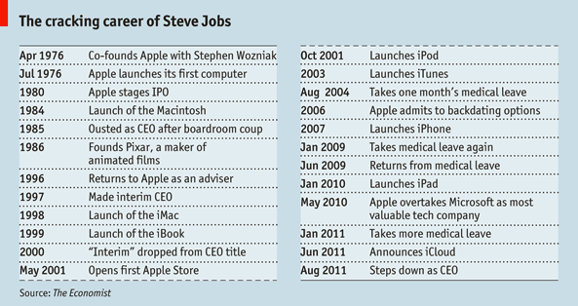
Apple Computer Major Events and Launches
1984 Macintosh Superbowl Ad: https://www.youtube.com/watch?v=ErwS24cBZPc

Slide 48
Resources and capabilities lead to
Competitive Advantage when they are:
Valuable
allow the firm to exploit opportunities or neutralize threats in its external environment
Rare
possessed by few, if any, current and potential competitors
In-imitatable
when other firms either cannot obtain them or must obtain them at a much higher cost
(Social complexity, causal ambiguity, history & path dependence)
Non-substitutable
Other resources possessed by competitors cannot create the equivalent value for customers
Notes:
52

Slide 49
Barriers to Entry and/or Imitation
Economies of scale: manufacturing, marketing, technological
Customer loyalty: well established brands, long established relationships
Agreements with customers, suppliers, strategic partners
Switching costs
Capital requirements: high investment. Sunk cost?

Slide 50
Barriers to Entry and/or Imitation
Access to distribution channels: exclusive distribution agreements, dominant position of competitors
Intellectual property: patents, trade secrets, copyrights, trademarks, know-how
Government regulations: Regulated monopolies, import restrictions
Hostility to new entrants: Use all means to drive out new competition: pricing, legal, spreading rumors
Network externalities and customer lock in

Slide 51
“The Core Competence of the Corporation”
Prahalad and Hamel
Core competencies are resources or capabilities that can serve as a source of competitive advantage across the entire corporation
Are the basis for a firm’s Strategic Competitiveness and Ability to Earn Above-average Returns.
Implications for Corporate Strategy
Vertical Integration
Diversification
Notes:
53

Slide 52
Other thoughts on strategy
No rules for riches
The failure of a strategy does not necessarily imply a bad strategy
Strategy is good luck rationalized by hindsight
Strategy is determined by what you decide not to do

Slide 53
Economic/Entrepreneurial Opportunity
The potential to achieve economic profit is commonly referred to as economic opportunity.
A favorable set of circumstances that create a need for a new product, service, or business
Also referred to as market gaps or imperfections
Opportunities are often hidden or difficult to pursue

Slide 54
Moneyball
What is the problem
https://www.youtube.com/watch?v=pWgyy_rlmag
Who are you?
https://www.youtube.com/watch?v=8DDMHwqIn3s
He gets on base
https://www.youtube.com/watch?v=PlKDQqKh03Y

Slide 55

Two Perspective on Opportunity: Opportunity Recognition Vs. Opportunity Creation
Opportunity Recognition refers to the ability of entrepreneurs to perceive market gaps or imperfections within the economic systems (Israel Kirzner)
Implies Discovery and Opportunity Identification are the keys to entrepreneurship
Trends, problems, unmet needs
Knowledge, experience, information, context and entrepreneurial alertness lead to discovery
World exists as objective reality and is knowable

Slide 56
Ex-ante and Ex-post Barriers (Limits) to Competition
Ex-ante limits; Required for the presence of opportunity
Ex-post limits; Required for sustainable competitive advantage and the longer-term generation of economic profit
Ex-ante means prior to some economic action
Ex-post means after some economic action

Slide 57
Opportunity Recognition and Opportunity Creation
Opportunity Creation refers to entrepreneurial actions that alter market systems to open up new opportunities for economic return.
Human Agency is the key to entrepreneurship
Create demand, build new institutions, influence government policy
Collective action, charisma, social movements
“Creative Destruction” (Joseph Schumpeter, 1934)
World is subjectively determined through individual action and interaction with social structures (structuration and instantiation)

Slide 58


Slide 59

Reading Discussion
What makes Entrepreneurs Entrepreneurial?
By Saras Sarasvathy
Notes:
What Makes Entrepreneurs Entrepreneurial?
What is effectual versus causal reasoning?
Start with means versus ends (goals)
Causal: “To the extent that we can predict the future, we can control it”
Effectual: To the extent that we can control the future, we do not need to predict it!
Conquerors versus explorers
Can use both
What does the author mean by means?
Three categories of means,
1. Who they are
2. What they know
3) Whom they know
Start small
Make and unmake and revise plans through action and interaction
Surprises are the norm-The unexpected as opportunity
What is affordable loss?
Competitive anlysis versus strategic partnerships?
Leveraging contingencies – Ready, fire, aim! – not all surprises are bad, but actually good. Inputs to venture creation process.
Urn example-
1. unknown distribution of colors. Discover distribution based on experimenting.
Future is created through actions of the players – Add more red balls to the urn
What did you think of the U-haul Example?
Lacked means, capital outlay too high.
No entry barriers
Started small
Built their own trailers
Striking orange paint
Gave away trailers to renters to establish dealers
Contracted with gas station chains for parking
Limited ads to yellow pages

Slide 60
Effectuation Videos
Video: Speech by Saras Sarasvathy (8 minutes)
Video: Intro to Effectuation (3 minutes)*
Video: Myths of Entrepreneurship – effectuation (10 minutes)

Slide 62
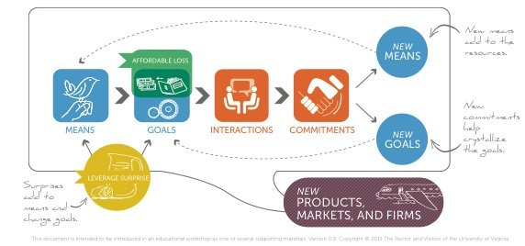

Slide 63
Where Good Ideas come From
Video: TED – Steven Johnson (17 minutes)
Notes:
Where Good Ideas Come From:
What is a “slow hunch”?
What ideas, products, or services can you think of that are good examples of a “slow hunch”?
What is a “liquid network”?
What ideas, products, or services can you think of that resulted from a “liquid network”?
What does your company do well to promote “creating good ideas”?
What could they do better?
What do you do well to “create good ideas”?
What could you do better?
Do you participate in “liquid networks”?
Where?
With whom?
Do you seek diversity of thought?
Or do you spend most of your time with people who look, act, and think like you?

